Slide 1
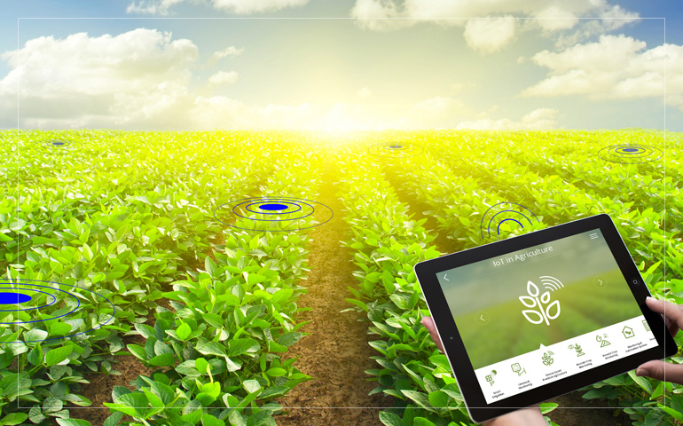
SMART IRRIGATION SYSTEM USING MACHINE LEARNING
BY G.ROHITHA
G.SUHITHA
G.PAVAN KUMAR G.PAVAN KUMAR
Notes:
BY
G.ROHITHA
G.SUHITHA
G.PAVAN KUMAR

Slide 2
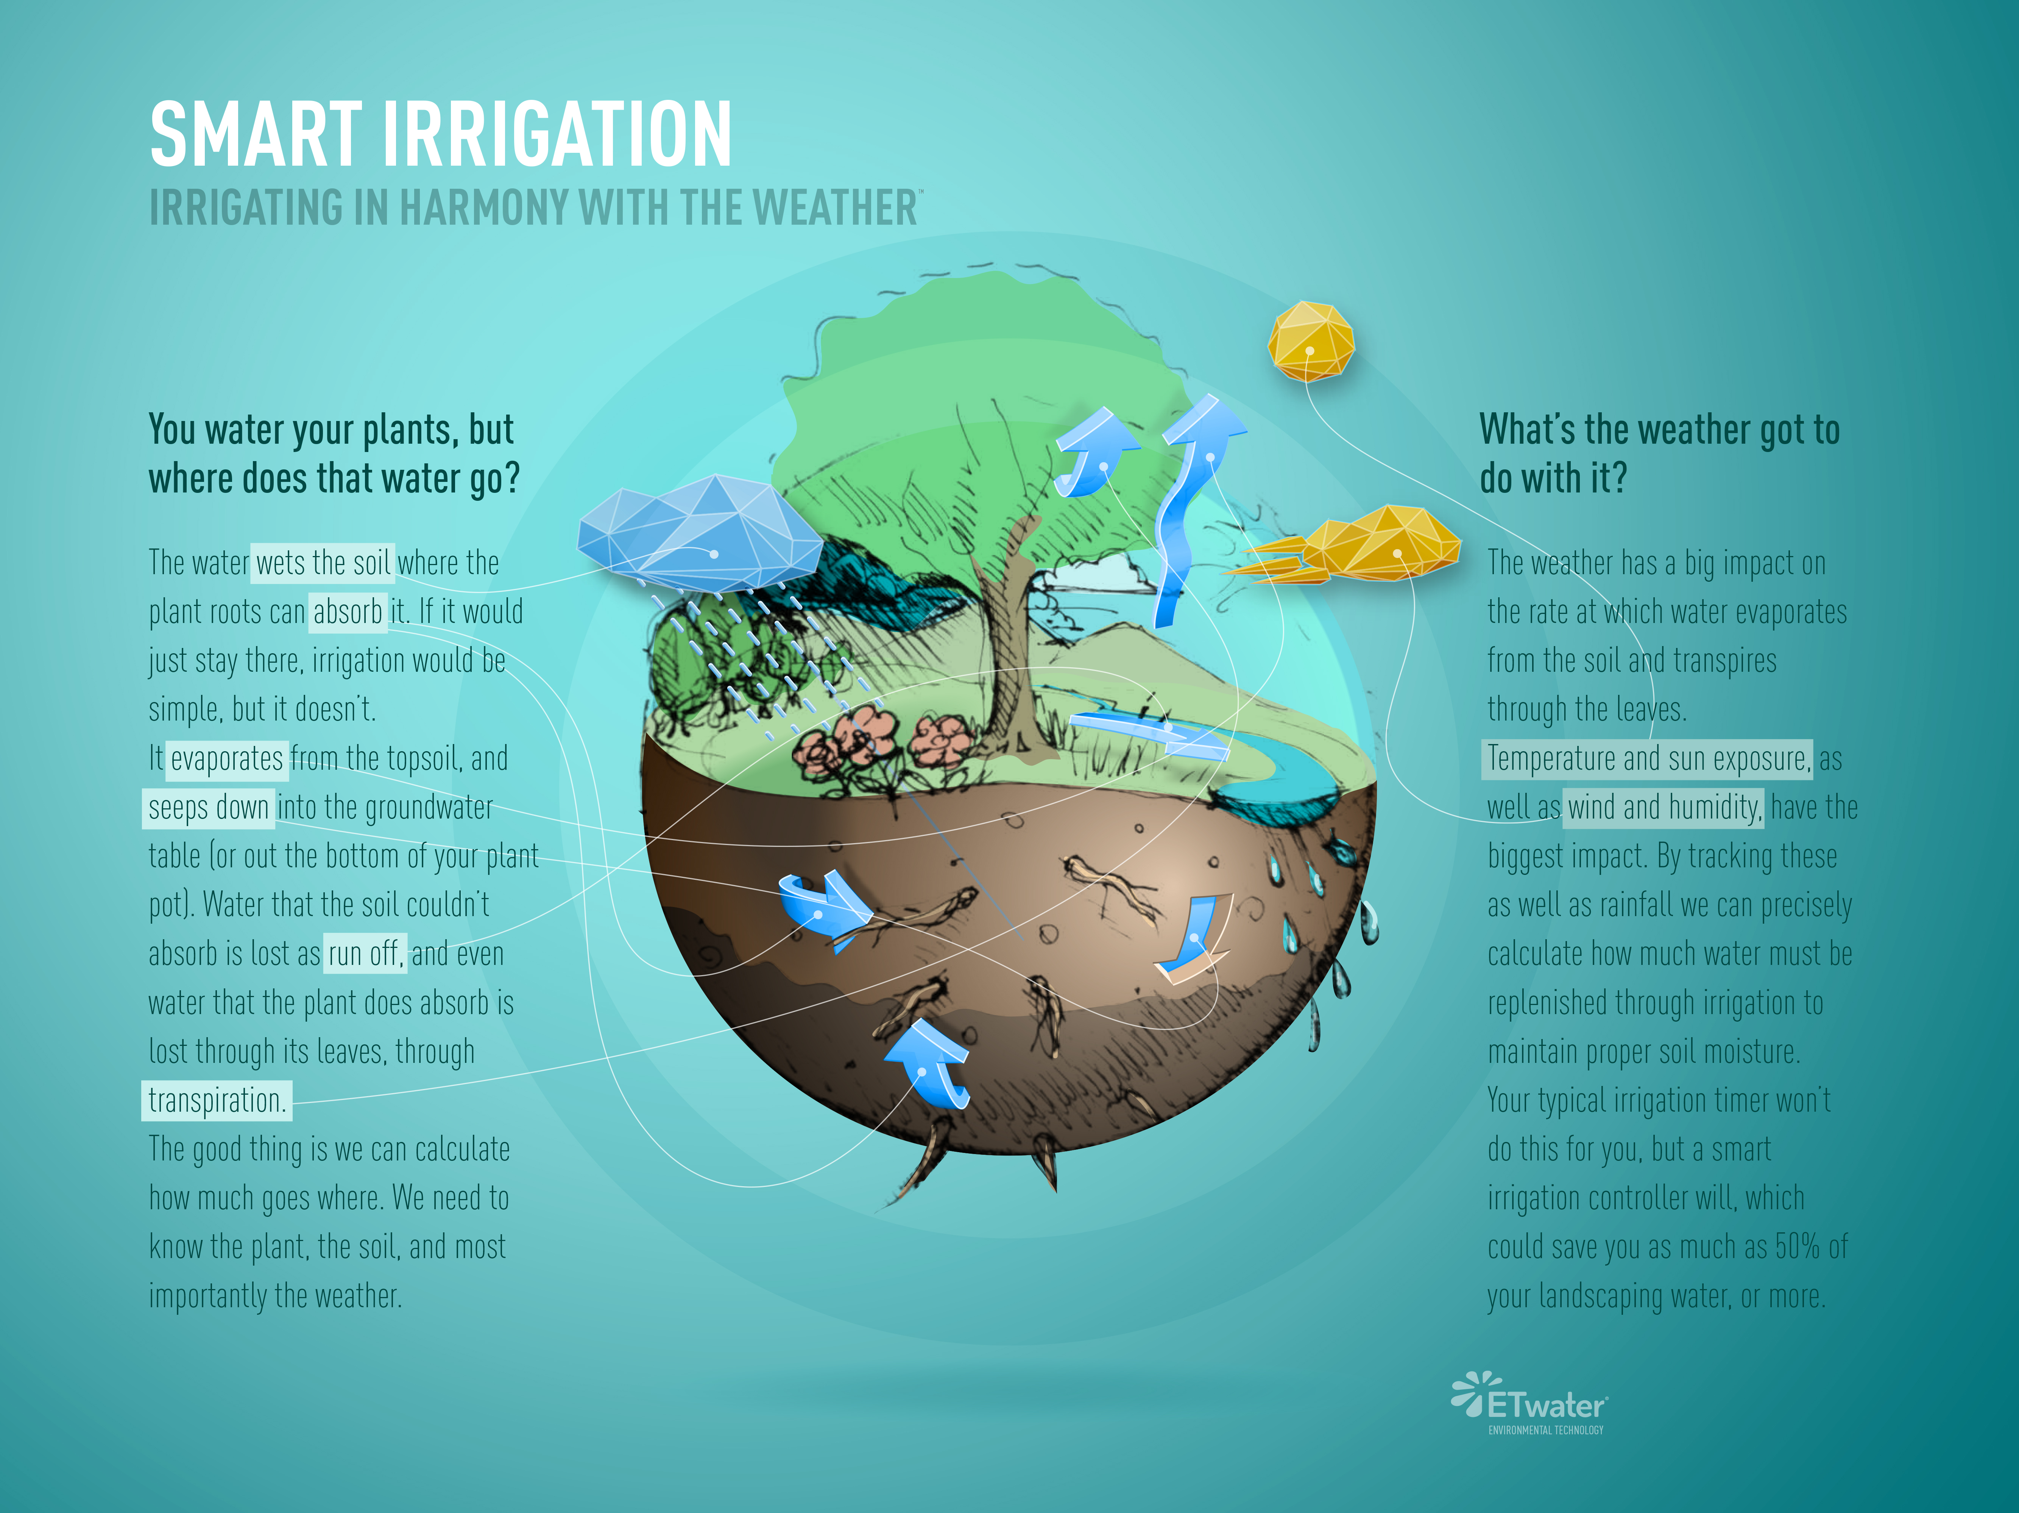

Slide 3
INTRODUCTION:
As agriculture is the backbone of the country and is major source of food production to the growing demand of human population. In agriculture, irrigation is an essential process that influences crop production. Generally farmers visit their agriculture fields periodically to check soil moisture level and based on requirement water is pumped by motors to irrigate respective fields. Traditional irrigation method takes lot of time and effort particularly when a farmer need to irrigate multiple agriculture fields distributed in different geographical areas.
The main motto of smart irrigation system is cost effective and a middle class farmer use it in farm field.Today we are living in 21st century where automation is playing important role in human life. Automation allows us to control appliances automatic control. It not only provide comfort but also reduce energy, efficiency and time saving. Today industries are use automation and control machine which is high in cost and not suitable for using in a farm field. So here we also design a smart irrigation technology in low cost which is usable by Indian farmers.

Slide 4
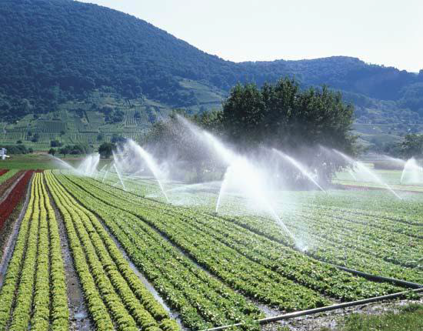
The objectives of this system were to control the water motor automatically and select the direction of the flow of water in pipe with the help of soil moisture sensor. Finally send the information(operation of the motor and direction of water) of the farm field to the android device or through gmail account sources.
In this we present a prototype for fully automation accessing of irrigation motor
where Prototype includes number of sensor node placed in different
directions of farm field. Each Sensors are integrated with a
wireless networking device and the data received by the
“ATMEGA-328” microcontroller which is on a “ARDUINO-UNO”
development board.The machine learning technology will not be
water allocation management, but instead, another aspect of
“situation awareness” within the system. Introducing new techniques in the cropland of irrigation with smart machine learning concept is a great combination.
Invoking machine learning in this embedded system and
automation made this system to be unique.

Slide 5
SIMULATION TOOLS:
The smart irrigation system consists of
1. Arduino Uno
2. Soil moisture sensor FC 28
3. Humidity sensor DHT-11
4. Submerged water pump 220V
5. wifi module ESP8266
6.4 Channel relay

Slide 6
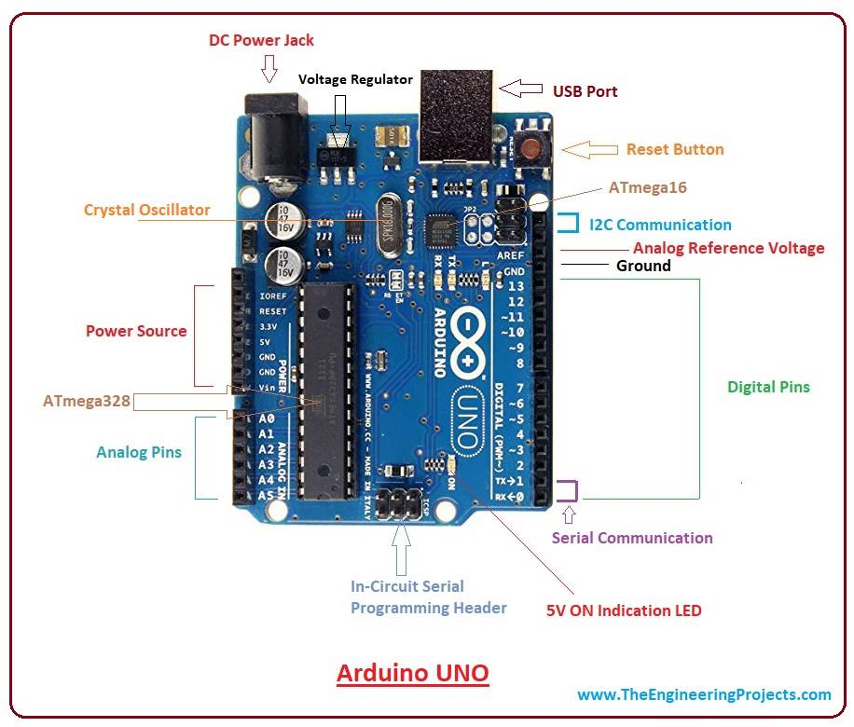
SYSTEM HARDWARE DESIGN:
The system hardware consists of
1.Arduino Uno:
The Arduino-Uno is a microcontroller board based on
the ATmega328. It has 14 digital input/output pins (of
which 6 can be used as PWM outputs), 6 analog inputs, a
16 MHz ceramic resonator, a USB connection, a power jack,
an ICSP header, and a reset button. It contains everything
needed to support the microcontroller; simply connect
it to a computer with a USB cable or power it with a
AC-to-DC

Slide 7
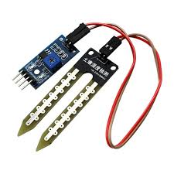
SOIL MOISTURE SENSOR:
Soil moisture sensor includes comparator (LM393) which converts
analog data to discrete. Two soil probes consist of two thin copper wires
each of 5 cm length which can be immersed into the soil under test.
The circuit gives a voltage output corresponding to the conductivity of soil.
The soil between the probes acts as a variable resistance whose value
depends upon moisture content in soil. The resistance across soil probes
can vary from infinity (for completely dry soil) to a very little resistance
(for 100% moisture in soil) his variation in resistance across the probes (RS) leads to variation in
forward-bias voltage which leads to corresponding variation in input base current (Ib). Hencevariation in base current leads to a large variation in emitter current and hence the emitter voltage is taken as the voltage
output of sensor .

Slide 8
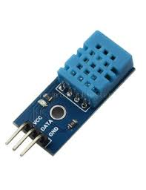
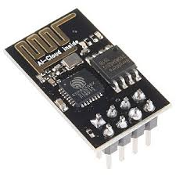
HUMIDITY SENSOR DHT11:
DHT11 is a humidity and temperature sensor,which generates calibrated digital
output.DHT11 can be interface with any microcontroller like Arduino
,raspberry Pi,etc.and get instantaneous results.DHT11 is a low cost humidity
and temperature sensor which provides high reliability and long term stability.
One of the main application of humidity sensor is Weather monitoring.
WIFI MODULE ESP 8266:
It is a low cost module,used to interface the microprocessors.it has 96kb of data
RAM as well as a 64kb of instruction RAM.ESP8266 maximum working
voltage is 3.6V.It is mostly used fordevelopment of IOT.It employs
32bit RISC CPU on running at 80mhz.

Slide 9
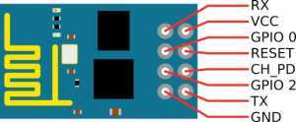
To communicate with ESP8266 module the microcontroller needs to use a set of AT commands.Micro controller communicates with this wifi module using UART having specific baud rate.
Pin Description of ESP8266 ESP-01 Module
VCC: It is the power pin through which 3.3V is supplied.
GND: It is the ground pin.
TX: This pin is used to transmit serial data to other devices.
RX: The RX pin is used to receive serial data from other devices.
RST: It is the Reset Pin and it is an active LOW Pin. (ESP8266
will reset if the RST pin receives LOW signal).
CH_PD: This is the chip enable pin and it is an active HIGH Pin.
It is usually connected to 3.3V.
GPIO0: The GPIO0 (General Purpose I/O) Pin has dual functions – one for normal GPIO Operation and other for enabling the Programming Mode of ESP8266.
GPIO2: This is GPIO Pin.

Slide 10
WORKING OF THE SYSTEM:
In the agriculture field ,sensors are used like soil moisture,humidity sensor. Soil moisture sensors are used to sense the moisture level in soil and send the data to wireless network device and the data from network device send to ARDUINO-UNO where an ATMEGA-328 Microcontroller process the data and calculate the percentage of dryness. The sensor data are voltage values so calculating percentage of dryness from voltage values usingan algorithm
Voltage= sensor value*(5/1023)
Percent= (voltage/5)*10
The ARDUINO board has 10-bit analog to digital converter.This means that it will map input voltages between 0
and 5 volts into integer values between 0 and 1023.This yields a resolution between readings of: 5 volts / 1024 units or, .0049 volts (4.9 mV) per unit.It takes about 100 microseconds (0.0001 s) to read an analog input, so the maximum reading rate is about 10,000 times a second [8]. Which generate a large number of data so we take a delay of 5minute. In each 5 minutes ARDUINO give one output value of percentage in dryness.The information received from sensors is sent to the database folder through the android device.

Slide 11
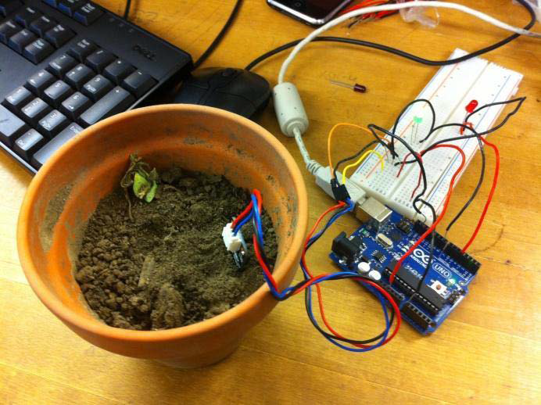
In the control section the system is activated using the application
.This is finished using the ON-OFF buttons in the application
.Also this system is automatically activated when soil moisture is low.
The pump is switched on based on moisture,humidity content.
The application has a feature like taking some time from the
user and water the agriculture field when time comes.In the
system there is a switch used to turn off the water supply if the
system fails.
Further this project can be enhanced by designing the system for large acres of soil.Also this project can be incorporated to make sure the value of the soil and expansion of harvest in its soil.

Slide 12
A recent study found that ,33% of the global population suffers from water scarcity smart irrigation systems can save up to 45% of water during dry season and even 85% of water in rainy season when compared to manually operated systems
SMART IRRIGATION SOLUTION BENEFITS
1. Cost effective
2.Irrigating at the correct times therefore minimizing runoff and other wastages
3. Reducing human error element
4.Intelligent irrigation decisions through machine learning.
5.Water conservation.
6.No risks for Over spraying or Over watering .
7.Incorporating the climatic parameters
8. Real time data and prediction in sight.

Slide 13
CONCLUSION:
By using the automatic irrigation system it optimizes the usage of water by reducing wastage and reduce the human intervention for farmers. It saves energy also as it automatic controlling the system. So there are the system is OFF when the field is wet and automatically start when the field id dry. It is implemented in all type of irrigations ystem (channel, sprinkler, drip). Machine learning in smart irrigation system is beneficial and profitable way for minimizing water resources usage in agricultural yield.The system is worn to cultivate in places where there is water shortage thereby developing comfort.This system is conversant and economical.It doesn’t need any individual on duty as it facile and reliable for cultivation process.

